Slide 1

Growing As Children of Light
Notes:
This graphic came from Jason Hardin. I am certain have I have used notes from Mark Copeland’s EO series, Randy Yerby, Aaron Fleenor and other in making these powerpoints. Further, images have been used from the internet that remain property of their owners. This can not be sold or used commercially. It can only be used for classroom (Bible class) purposes.

Slide 2
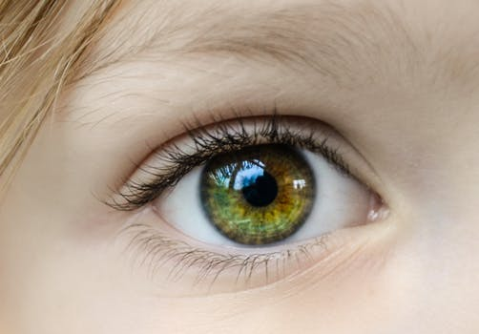
Eyeing Second Peter
Building On God’s Promises
Escaping the Corruption in the World
Partaking of the Divine Nature
Week 13 : Partaking of the Divine Nature

Slide 3

Eyeing Second Peter
Weekly study plan:
Read 2 Peter once a week
Work on the memory verse by reading it carefully aloud at least eleven times this week

Slide 4
Memory Passage: 2 Peter 1:3-4
According as his divine power hath given unto us all things that pertain unto life and godliness,
through the knowledge of him that hath called us to glory and virtue:
Whereby are given unto us exceeding great and precious promises:
that by these ye might be partakers of the divine nature,
having escaped the corruption that is in the world through lust.

Slide 5
Remembering Second Peter
Blindness and Myopia Control
Eyes Full of Adultery
Twinkling of an Eye
Holiness – Heresy – Hope
Cultivate Christian Character
Condemnation of false teachers
Confidence in Christ’s return
Read 10X, 10 Classes, Mechanism, Memory verse

Slide 6
Build on God’s Promises Growing As Children of Light
Growing in the knowledge of Jesus Christ requires developing a Christ-like character, partaking of the divine nature (holiness).
This requires all diligence to develop seven “graces”, in our lives, in conjunction with each other.
2 Peter 1:5-10 ⁵ And beside this, giving all diligence, add to your faith virtue; and to virtue knowledge;⁶ And to knowledge temperance; and to temperance patience; and to patience godliness;⁷ And to godliness brotherly kindness; and to brotherly kindness charity.⁸ For if these things be in you, and abound, they make you that ye shall neither be barren nor unfruitful in the knowledge of our Lord Jesus Christ.⁹ But he that lacketh these things is blind, and cannot see afar off, and hath forgotten that he was purged from his old sins.¹⁰ Wherefore the rather, brethren, give diligence to make your calling and election sure: for if ye do these things, ye shall never fall:
Notes:
6

Slide 7
Review: The Development of Seven Graces
With all diligence
Escaping corruption in world through lust (sin and grace)
Faith – “conviction and strong assurance”
Virtue – “moral excellence, goodness”
Knowledge – “correct insight”
Self-control - "self-discipline"
Patience / Perseverance - "bearing up under trials"
Godliness - "godly character out of devotion to God"
Brotherly Kindness - "love toward brethren"
Love - "active goodwill toward others” (not this quarter)
Add - Not the idea of stair steps, but rather of a chorus working in harmony to produce an overall result.

Slide 8
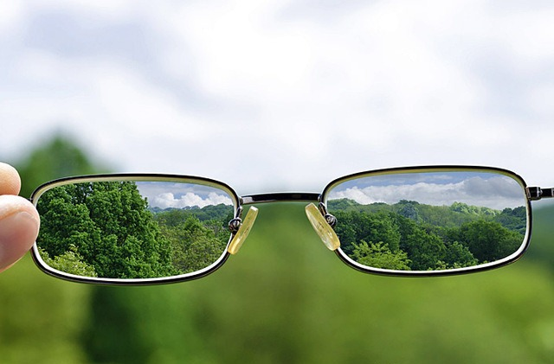
Review Spiritual “Myopia” / “Blindness” Avoided
Our faith is "shortsighted" to blindness if we are not growing in the knowledge of Jesus! Each of these helps battle against myopia/blindness. 2 Peter 1:9
Romans 8:28-29And we know that all things work together for good to them that love God, to them who are the called according to his purpose. ²⁹ For whom he did foreknow, he also did predestinate to be conformed to the image of his Son, that he might be the firstborn among many brethren.
Colossians 3:9-11 Lie not one to another, seeing that ye have put off the old man with his deeds;¹⁰ And have put on the new man, which is renewed in knowledge after the image of him that created him:¹¹ Where there is neither Greek nor Jew, circumcision nor uncircumcision, Barbarian, Scythian, bond nor free: but Christ is all, and in all.

Slide 9
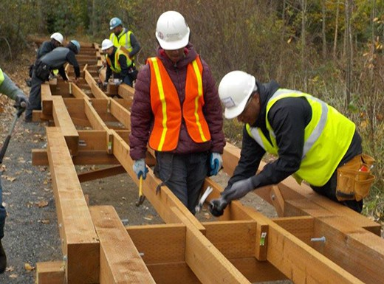
Building on the Promises
So many. Through/by Christ, we have promises
Acts 13:32-33 Promise to fathers fulfilled in Christ
And we declare unto you glad tidings, how that the promise which was made unto the fathers,God hath fulfilled the same unto us their children, in that he hath raised up Jesus again; as it is also written in the second psalm, Thou art my Son, this day have I begotten thee.
Description: great and precious – emphasis and power
By these = through these
Through these can share in divine nature

Slide 10
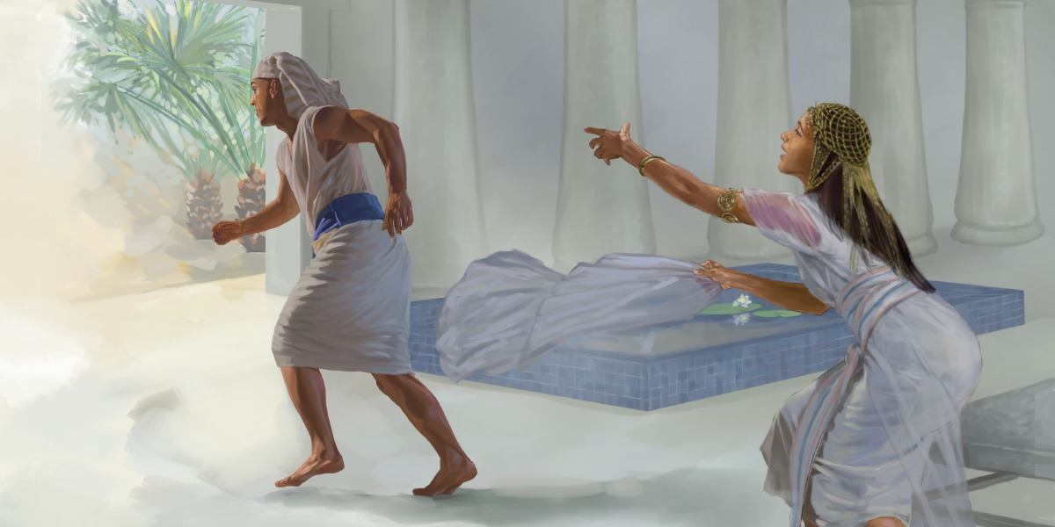
Escaping the Corruption (sin & grace)
1 John 4:1 – Test if Promises from God
John 8:44 - Satan lies and deceives
2 Peter 2 - False teachers are sensual, arrogant, greedy, covetous
Gal 6:7-8 - Principle of Sow and reap
2 Peter 2:18-22 - Can again turn to corruption
Rom 1:23-32 – Reprobate mind

Slide 11
Is partaking of the Divine Nature substantive or qualitative?
What does partaking of the Divine Nature (Holiness) look like in our lives?

Slide 12
Partaker of the Divine Nature
Koinonos = partakers
“denoting a companion, partner, partaker” Vine III:161
“A partaker, sharer ….’ Thayer 352
Phusis “the sum of innate properties and powers by which one person differs from others, distinctive native peculiarities, natural characteristics … (the holiness distinctive of divine nature is specially referred to), 2 Pet. i.4” Thayer 661 (Bold my emphasis)

Slide 13
Partaker of the Divine Nature
Substance vs. Quality
“The qualities and characteristics of this nature are reflected in those who are obedient to the word of God.” Hamilton, 29
Jn 1:12-13 But as many as received him, to them gave he power to become the sons of God, even to them that believe on his name: Which were born, not of blood, nor of the will of the flesh, nor of the will of man, but of God.
1 Peter 1:23
Eph 4:23

Slide 14
Partaker of the Divine Nature
Substance vs. Quality
1 Peter 1:23 Being born again, not of corruptible seed, but of incorruptible, by the word of God, which liveth and abideth for ever.
Eph 4:21-23 That ye put off concerning the former conversation the old man, which is corrupt according to the deceitful lusts; And be renewed in the spirit of your mind; And that ye put on the new man, which after God is created in righteousness and true holiness.

Slide 15
Partaker of the Divine Nature
Substance vs. Quality
2 Cor 6:18-7:1 And will be a Father unto you, and ye shall be my sons and daughters, saith the Lord Almighty. Having therefore these promises, dearly beloved, let us cleanse ourselves from all filthiness of the flesh and spirit, perfecting holiness in the fear of God.
Do you see a parallel to 2 Peter 1:4?

Slide 16
Partaker of the Divine Nature
Substance vs. Quality
Holiness and righteousness are two attributes of God. Being in fellowship with God does NOT make one diety, but the idea of something shared or in communion is prominent.
Gal 2:20 am crucified with Christ: nevertheless I live; yet not I, but Christ liveth in me: and the life which I now live in the flesh I live by the faith of the Son of God, who loved me, and gave himself for me.

Slide 17
Partaker of the Divine Nature
Substance vs. Quality
Share or in communion is prominent.
Phil 1:21 For to me to live is Christ, and to die is gain.
John 15:4 Abide in me, and I in you. As the branch cannot bear fruit of itself, except it abide in the vine; no more can ye, except ye abide in me.
John 14:23 Jesus answered and said unto him, If a man love me, he will keep my words: and my Father will love him, and we will come unto him, and make our abode with him.

Slide 18
Partaker of the Divine Nature
Substance vs. Quality
Share or in communion is prominent.
1 John 2:23-25 Whosoever denieth the Son, the same hath not the Father: (but) he that acknowledgeth the Son hath the Father also. Let that therefore abide in you, which ye have heard from the beginning. If that which ye have heard from the beginning shall remain in you, ye also shall continue in the Son, and in the Father. And this is the promise that he hath promised us, even eternal life.
Class focused on qualities

Slide 19
What is godliness?
How does it relate to partaking of the divine nature?

Slide 20
Recall: Defining Godliness
From “Eu, well” and “Sebomai, to be devout”
Characterized by a godly attribute, does that which pleases
God-like-ness
“The human person does not merge with some sort of impersonal divine force, losing individual identity or consciousness. Intrinsic divinity is never ascribed to humankind or any part of the creation, and no created thing is confused with the being of God. Most certainly, humans are not accorded ontological equality with God, nor are they considered to merge or co-mingle with the being of God as He is in His essence. We become united with God by grace in the Person of Christ, who is God come in the flesh. The means of becoming “like God” is through perfection in holiness, the continuous process of acquiring the Holy Spirit by grace” – Mark Shuttleworth
“The gradual process by which a person is renewed and unified so completely with God that he becomes by grace what God is by nature.” – David Hester in The Jesus Prayer

Slide 21

Being like Christ
John 13:12-17 15 For I have given you an example, that you should do as I have done to you.
Romans 12:1–2
1 Corinthians 3:16; 6:17: We are reminded that we are God’s “temple” and that “he who is joined to the Lord is one spirit with Him
Galatians 2:20: “It is no longer I who live, but Christ who lives in me.”

Slide 22
Being like Christ
Philippians 1:21: “For me, to live is Christ.”
Colossians 3:3: We have “died” and our lives are “hidden with Christ in God”—total commitment to Christ.
1 Thessalonians 5:23: May God “sanctify you completely”—complete conformity to the image and likeness of God.
2 Thessalonians 2:14: We were called by God “for the obtaining of the glory of our Lord Jesus Christ.”
1 John 3:2: “We know that when He is revealed, we shall be like Him, for we shall see Him as He is.”
Philippians 3:21: Christ will “transform our lowly body that it may be conformed to His glorious body.”

Slide 23
Partakers of the Divine Nature Children of God/Sons/ Heirs
Genesis 1:26-27 And God said, Let us make man in our image, after our likeness: and let them have dominion over the fish of the sea, and over the fowl of the air, and over the cattle, and over all the earth, and over every creeping thing that creepeth upon the earth. 27 So God created man in his own image, in the image of God created he him; male and female created he them.

Slide 24
Partakers of the Divine Nature Children of God/Sons/ Heirs
Hebrews 1:1-3 God, who at sundry times and in divers manners spake in time past unto the fathers by the prophets, 2 hath in these last days spoken unto us by his Son, whom he hath appointed heir of all things, by whom also he made the worlds; 3 who being the brightness of his glory, and the express image of his person, and upholding all things by the word of his power, when he had by himself purged our sins, sat down on the right hand of the Majesty on high

Slide 25
Partakers of the Divine Nature Children of God/ Sons/ Heirs
Acts 17:28–29, for in Him we live and move and have our being, as also some of your own poets have said, ‘For we are also His offspring.’ 29 Therefore, since we are the offspring of God, we ought not to think that the Divine Nature is like gold or silver or stone, something shaped by art and man’s devising.

Slide 26
What two chapters might in a broader discussion help the child of God understand partaking of the divine nature? How would you summarize what one learns?

Slide 27
Partakers of the Divine Nature Children of God/ Sons/ Heirs
In Ephesians 1, we have been given “every spiritual blessing” (v. 3) so that we should be “holy and without blame” (v. 4); we are His “sons” (v. 5). He made “the riches of His grace . . . to abound toward us” (vv. 6–7). We are given wisdom and insight into the “mystery of His will” (v. 9), which is to “gather together in one all things in Christ” (v. 10). Furthermore, we are “sealed with the Holy Spirit of promise” (v. 13), the “guarantee of our inheritance until the redemption of the purchased possession” (v. 14). We are recipients of “wisdom and revelation” (v. 17), having “the eyes of [our] understanding . . . enlightened” (v. 18); knowing the “exceeding greatness of His power toward us” (v. 19). We are the “body” of Him who is the head and “the fullness of Him who fills all in all” (v. 23). “be filled with all the fullness of God” (3:19) and to attain to “the measure of the stature of the fullness of Christ” (4:13). We are to “grow up in all things into Him who is the head—Christ” (4:15).

Slide 28
Partakers of the Divine Nature Children of God/ Sons/ Heirs
In Romans 6, through baptism we “walk in newness of life” (v. 4). We are not to let sin “reign in [our] mortal body” (v. 12), but are to “present [ourselves] to God” (v. 13) so that sin will “not have dominion over” us (v. 14). Our members are to be yielded to “righteousness for holiness” (v. 19). Therefore we have “been set free from sin, and have become slaves of God” (v. 22). Our hope is to share in “the glory of God” (5:2). Even the very creation “eagerly waits for the revealing of the sons of God” (8:19). Continuing in chapter 8, we are called “sons of God” (v. 14) who have received a “Spirit of adoption,” crying (as Jesus did) “Abba, Father” (v. 15). The Spirit bears witness “with our spirit”—that we are “children of God” (v. 16). As His children, we are “heirs of God and joint heirs with Christ ... that we may also be glorified together” (v. 17). In verse 29, we are to be “conformed to the image of His Son.” Furthermore, those He “justified, these He also glorified” (v. 30).

Slide 29
Partakers of the Divine Nature Children of God/ Sons/ Heirs
In Ephesians 4:23–24: “be renewed in the spirit of your mind” and “put on the new man which was created according to God, in true righteousness and holiness.” And in 5:1 we told to be “imitators of God.”
Do you reflect Christ in your…
THOUGHTS
WORDS
DEEDS?

Slide 30
How do we understand God’s holiness?
What is the impact on us?

Slide 31
God’s Holiness
God is Holy, Holy, Holy
God is unique, separate, sacred, and physically unapproachable
God is Deity – above us in all ways
Are we humble? Attitude in worship, prayer, daily walk?
God is absolute moral perfection
God is opposed to sin because He is holy.
Sin separates us from God, brings His wrath
However, we are called to be holy (perfect)
Put away former lusts
Imitate God and Christ
Careful of our daily lives
Grow in God

Slide 32
How can we be holy as God wants us to be? How does one perfect holiness?

Slide 33
Partaking of the Divine Nature Is About Holiness
2 Peter 3:11-14 Seeing then that all these things shall be dissolved, what manner of persons ought ye to be in all holy conversation and godliness, Looking for and hasting unto the coming of the day of God, wherein the heavens being on fire shall be dissolved, and the elements shall melt with fervent heat? Nevertheless we, according to his promise, look for new heavens and a new earth, wherein dwelleth righteousness. Wherefore, beloved, seeing that ye look for such things, be diligent that ye may be found of him in peace, without spot, and blameless

Slide 34
The Holiness of God God’s Desire for the Church
1 Peter 1:13-16 “13 Wherefore gird up the loins of your mind, be sober, and hope to the end for the grace that is to be brought unto you at the revelation of Jesus Christ; 14 As obedient children, not fashioning yourselves according to the former lusts in your ignorance: 15 But as he which hath called you is holy, so be ye holy in all manner of conversation; 16 Because it is written, Be ye holy; for I am holy.”

Slide 35
The Holiness of God God’s Desire for the Church
Ephesians 1:4-7 “4 According as he hath chosen us in him before the foundation of the world, that we should be holy and without blame before him in love: 5 Having predestinated us unto the adoption of children by Jesus Christ to himself, according to the good pleasure of his will, 6 To the praise of the glory of his grace, wherein he hath made us accepted in the beloved. 7 In whom we have redemption through his blood, the forgiveness of sins, according to the riches of his grace;

Slide 36
The Holiness of God God’s Desire for the Church
We are to be like HIM!!
HOW CAN WE BE HOLY
AS HE IS HOLY?

Slide 37
The Holiness of God God’s Desire for the Church “Be ye holy; for I am holy”
2 Peter 2:3-4 According as his divine power hath given unto us all things that pertain unto life and godliness, through the knowledge of him that hath called us to glory and virtue: Whereby are given unto us exceeding great and precious promises: that by these ye might be partakers of the divine nature, having escaped the corruption that is in the world through lust.

Slide 38
The Holiness of God How Can We Be Holy?
Hebrews 10:19-22 Having therefore, brethren, boldness to enter into the holiest by the blood of Jesus, 10:20 By a new and living way, which he hath consecrated for us, through the veil, that is to say, his flesh; 10:21 And having an high priest over the house of God; 10:22 Let us draw near with a true heart in full assurance of faith, having our hearts sprinkled from an evil conscience, and our bodies washed with pure water.
We are made holy in Jesus Christ!
We are then called to a life of holiness.

Slide 39
The Holiness of God We Are Called to Be Holy
2 Cor 7:1 Having therefore these promises, dearly beloved, let us cleanse ourselves from all filthiness of the flesh and spirit, perfecting holiness in the fear of God.
2 Cor 7:1 (ESV) Since we have these promises, beloved, let us cleanse ourselves from every defilement of body and spirit, bringing holiness to completion in the fear of God.

Slide 40
The Holiness of God We Are Called to Be Holy
Rom 12:1-2 I beseech you therefore, brethren, by the mercies of God, that ye present your bodies a living sacrifice, holy, acceptable unto God, which is your reasonable service. 2 And be not conformed to this world: but be ye transformed by the renewing of your mind, that ye may prove what is that good, and acceptable, and perfect, will of God.

Slide 41
The Holiness of God We Are Called to Be Holy
1 Thes 4:3-7 3 For this is the will of God, even your sanctification, that ye should abstain from fornication: 4That every one of you should know how to possess his vessel in sanctification and honour; 5Not in the lust of concupiscence, even as the Gentiles which know not God: 6That no man go beyond and defraud his brother in any matter: because that the Lord is the avenger of all such, as we also have forewarned you and testified. 7For God hath not called us unto uncleanness, but unto holiness. 8He therefore that despiseth, despiseth not man, but God, who hath also given unto us his holy Spirit.

Slide 42
The Holiness of God How Do We Remain Holy?
1 John 1:7-10 7But if we walk in the light, as he is in the light, we have fellowship one with another, and the blood of Jesus Christ his Son cleanseth us from all sin. 8If we say that we have no sin, we deceive ourselves, and the truth is not in us. 9If we confess our sins, he is faithful and just to forgive us our sins, and to cleanse us from all unrighteousness. 10If we say that we have not sinned, we make him a liar, and his word is not in us.

Slide 43
The Holiness of God We Must Strive for Holiness!
It does make a difference how we live our daily lives
God does see our sins.
God expects us to exercise self-control
God expects us to grow, especially in times of trial.

Slide 44
Discussion: Psalms 82:6-7, John 10:34-36, and theosis
Psalms 82:6-7 I said, “You are gods, And all of you are children of the Most High. 7 But you shall die like men, And fall like one of the princes.”

Slide 45
Discussion: Psalms 82:6-7, John 10:34-36, and theosis
John 10:33-39 The Jews answered Him, saying, “For a good work we do not stone You, but for blasphemy, and because You, being a Man, make Yourself God.”34 Jesus answered them, “Is it not written in your law, ‘I said, “You are gods”’? 35 If He called them gods, to whom the word of God came (and the Scripture cannot be broken), 36 do you say of Him whom the Father sanctified and sent into the world, ‘You are blaspheming,’ because I said, ‘I am the Son of God’? 37 If I do not do the works of My Father, do not believe Me; 38 but if I do, though you do not believe Me, believe the works, that you may know and believe that the Father is in Me, and I in Him.” 39 Therefore they sought again to seize Him, but He escaped out of their hand.

Slide 46
Discussion: Psalms 82:6-7, John 10:34-36, and theosis
“Orthodox” idea of theosis:
“Jesus is truly God’s Son, and we are gods because we share in His sonship.”
We are “renewed and unified so completely with God that we become by grace what God is by nature.”

Slide 47
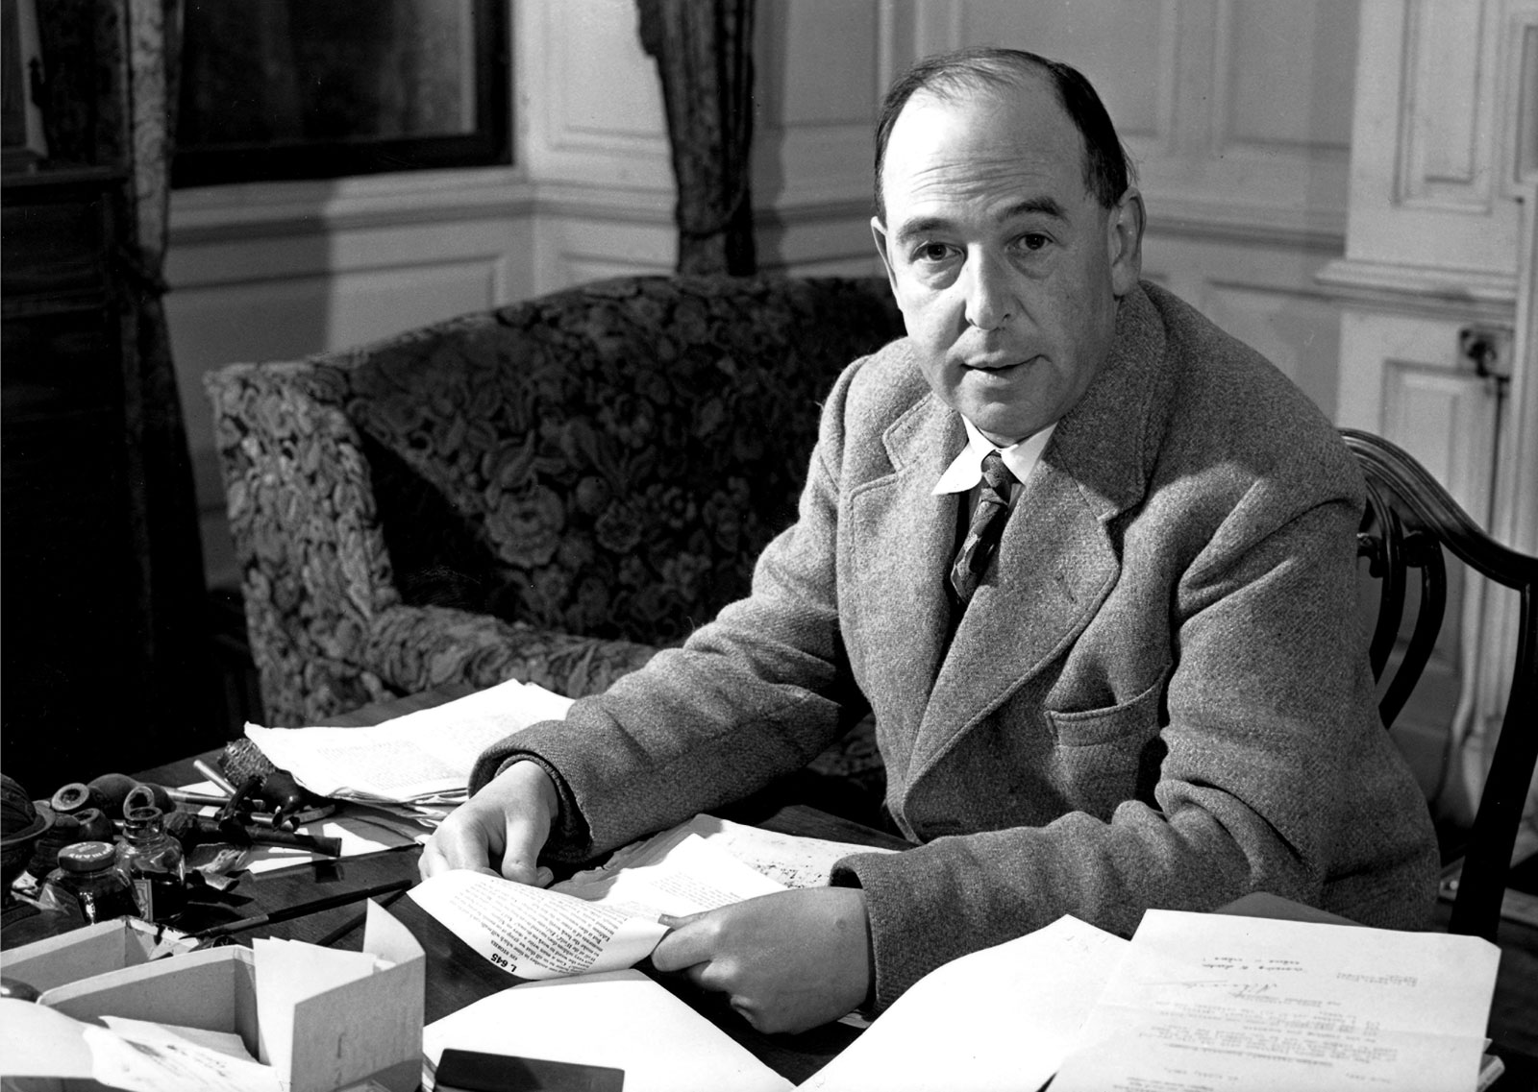
Discussion: Psalms 82:6-7, John 10:34-36, and theosis
The command “Be ye perfect” is not idealistic gas. Nor is it a command to do the impossible. He is going to make us into creatures that can obey that command. He said (in the Bible) that we were “gods” and He is going to make good His words. If we let Him—for we can prevent Him, if we choose—He will make the feeblest and filthiest of us into a god or goddess, dazzling, radiant, immortal creatures, pulsating all through with such energy and joy and wisdom and love as we cannot now imagine, a bright stainless mirror which reflects back to Him perfectly (though, of course, on a smaller scale) His own boundless power and delight and goodness. The process will be long and in parts very painful; but that is what we are in for. Nothing less. He meant what he said. -- C. S. Lewis in Mere Christianity: Macmillan, 1952, p. 174.

Slide 48

Discussion: Psalms 82:6-7, John 10:34-36, and theosis
“John 10:34-35 as interpretation of Psalm 82 is, as I'm sure you're well aware, fraught with complications. This is where Mormons justify their idea of God having been a man and that men can become gods; they were just going down the line started by the Eastern Orthodox and their idea of theosis, that man can become as god. To combat this some attempt to suggest that gods, in Psalm 82, actually are judges, based on a possible minor definition of Hebrew elohim. That may make things easier on the Psalm end, but such is not the way Jesus understands the passage. But Psalm 82 is just that: a psalm. It's poetry. Asaph does not actually believe these people are gods; they will die like men, after all. But they act as if they were gods. They will receive their humiliation. I believe Jesus is using this to show that it was not impossible to think of God as coming in human form: if Asaph could compare these people to gods, on what basis do you say it must be blasphemy to suggest that I am the Son of God? Therefore we must always keep the tension in mind: on the one hand, we are called to be holy as God is holy and to be godly in thought, feeling, word, and deed; but we will never be God, and we should never presume to be as God in our thinking, feeling, and acting.” -- Ethan Longhenry (personal correspondence)

Slide 49
Discussion: Psalms 82:6-7, John 10:34-36, and theosis
Philippians 2:5-11 5 Let this mind be in you, which was also in Christ Jesus: 6 who, being in the form of God, thought it not robbery to be equal with God: 7 but made himself of no reputation, and took upon him the form of a servant, and was made in the likeness of men: 8 and being found in fashion as a man, he humbled himself, and became obedient unto death, even the death of the cross. 9 Wherefore God also hath highly exalted him, and given him a name which is above every name: 10 that at the name of Jesus every knee should bow, of things in heaven, and things in earth, and things under the earth; 11 and that every tongue should confess that Jesus Christ is Lord, to the glory of God the Father.

